Slide 1
Weekly Project Status
Team Members
Mumtahina Mim (2095)
MD. Nazmul Alam Khan Akram (1941)
Mehedi Hasan (346)
Jannatul Mawa (1943)
Dilara Yasmin (295)
Md. Mahadi Islam (2465)
Md. Hemal Rahman (344)

Slide 2
Objective
Clean JU is an animation based project focusing on an important issue: placing sufficient dustbins in Jahangirnagar University campus.
To create an awareness video on keeping JU environment clean.

Slide 3
Project Contributors
Project Manager → Mumtahina MIm
Script writer → Mehedi Hasan, Md.Hemal Rahman
Art Director → Jannatul Mawa, Dilara Yasmin
UI Designer → Md.Nazmul Alam Khan
Production Artist(Voice) → Mahadi Islam, Mehedi Hasan, Md.Nazmul Alam
Production Artist(Sketch) → Mumtahina Mim, Jannatul Mawa
Sound Designer → Jannatul Mawa, Mumtahina Mim, Dilara Yasmin
Video Editor → Md.Nazmul Alam Khan, Mehedi Hasan, Md.Hemal Rahman
Animators → All team members

Slide 4
Progress so far..
Tools Selected:
Kdenlive
Blender
FlipaClip
Krita
Adobe After Effects
Storyboarding
Script Writing
Background Sound Selection
Mixkit: https://mixkit.co/free-sound-effects/
Envato: https://elements.envato.com/sound-effects
Welcome frame

Slide 5
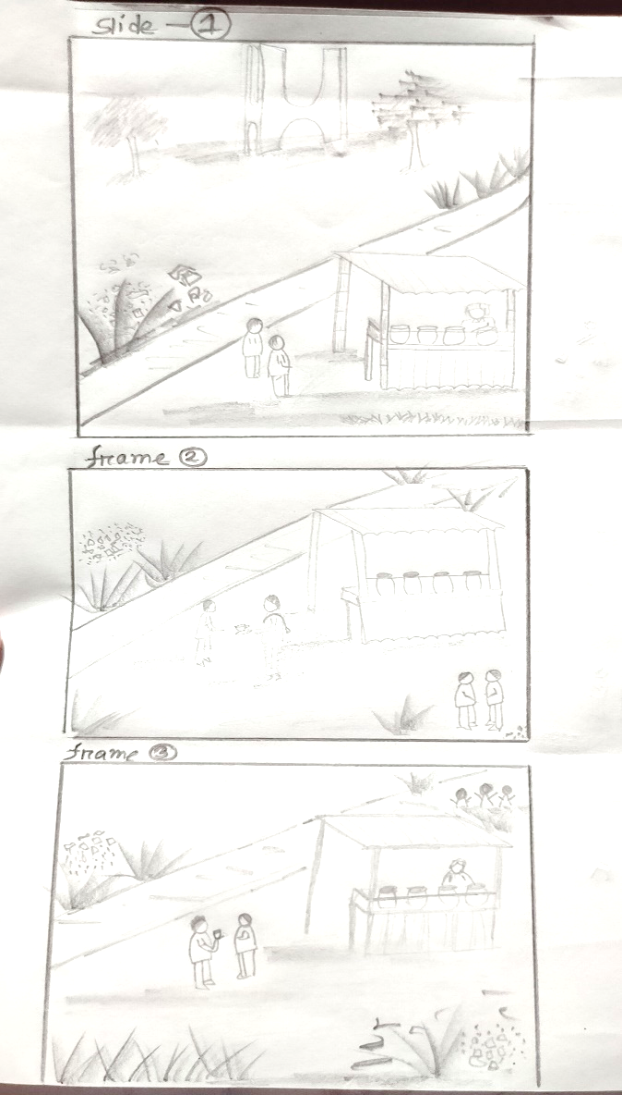
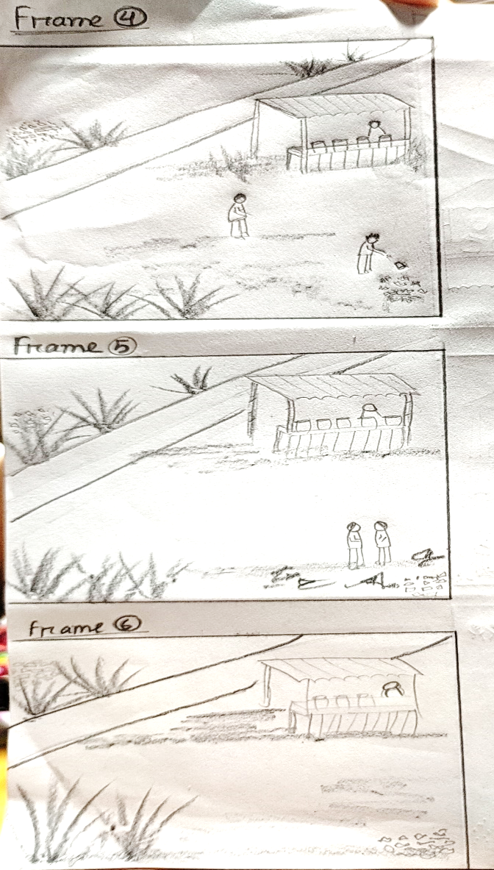
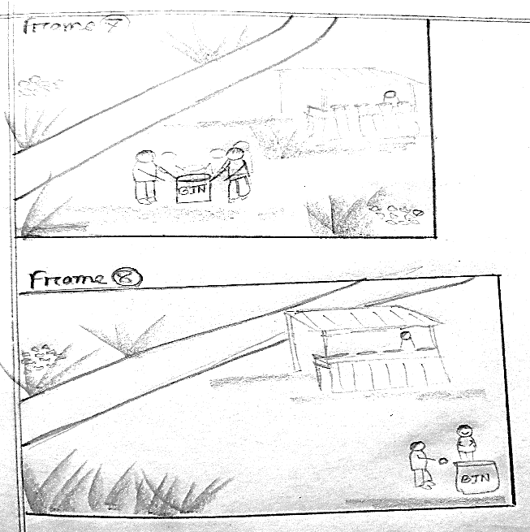
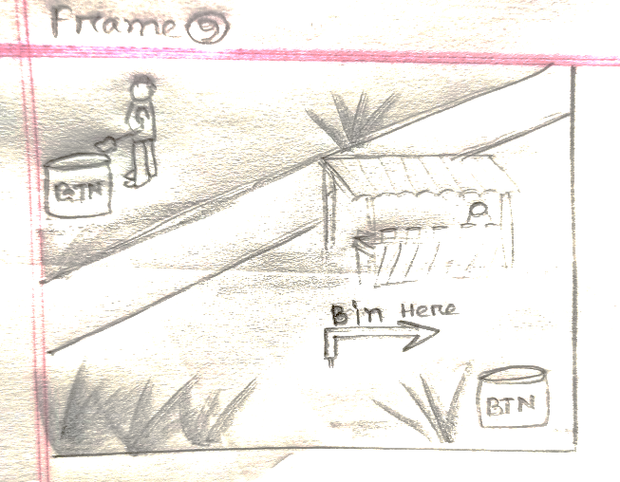
Story Board

Slide 6
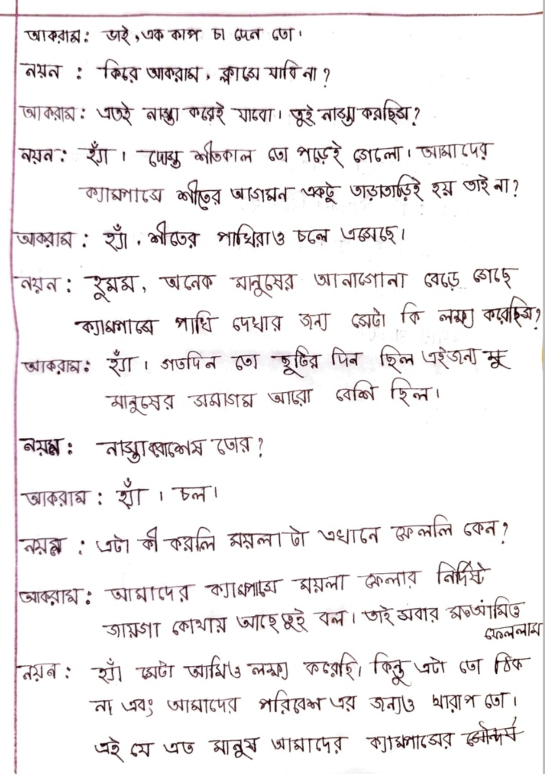
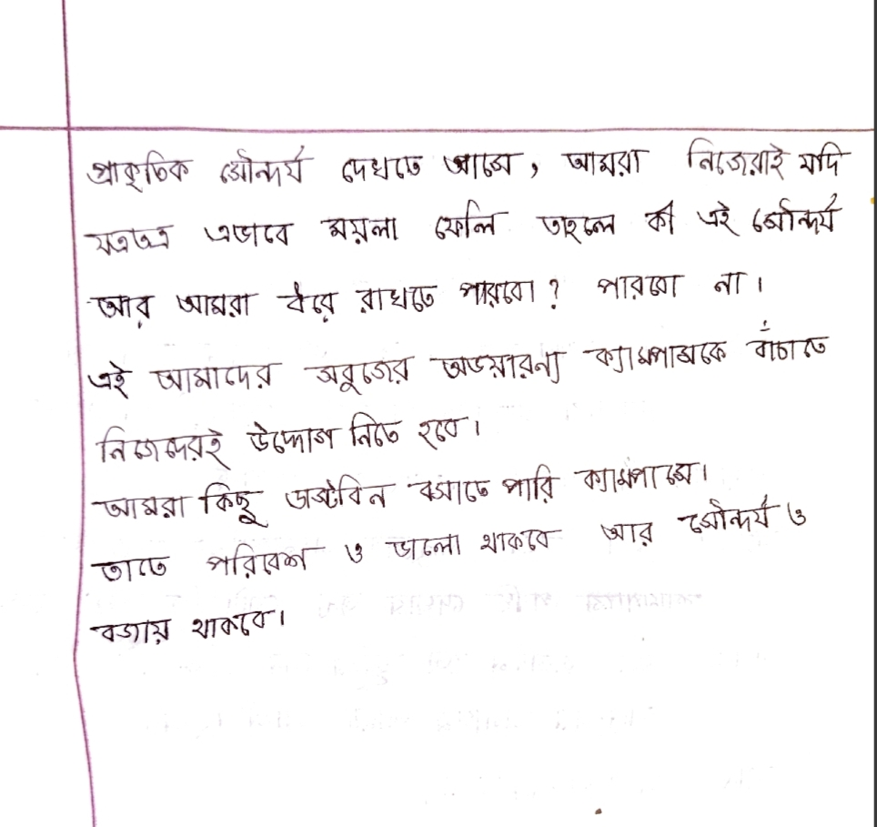
Script

Slide 7
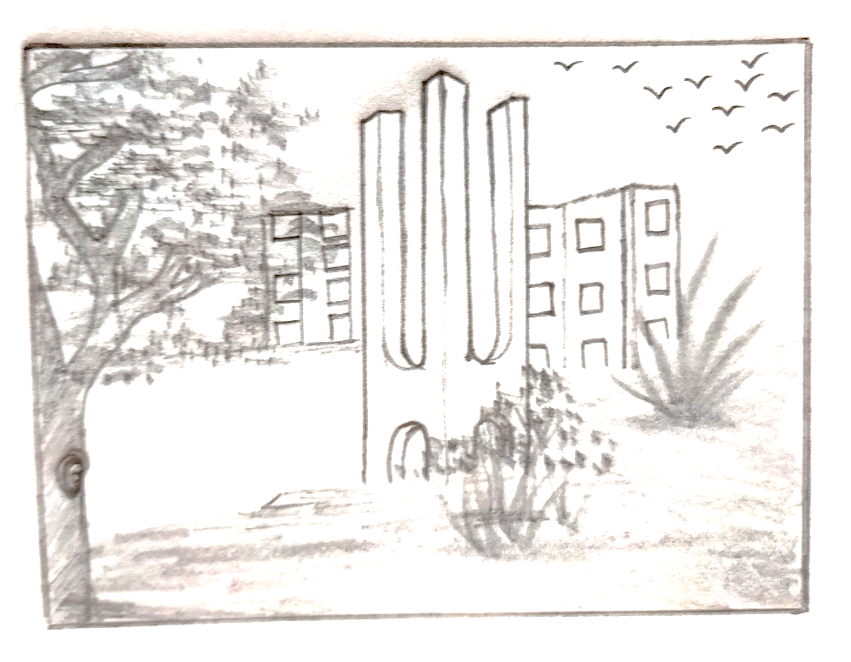
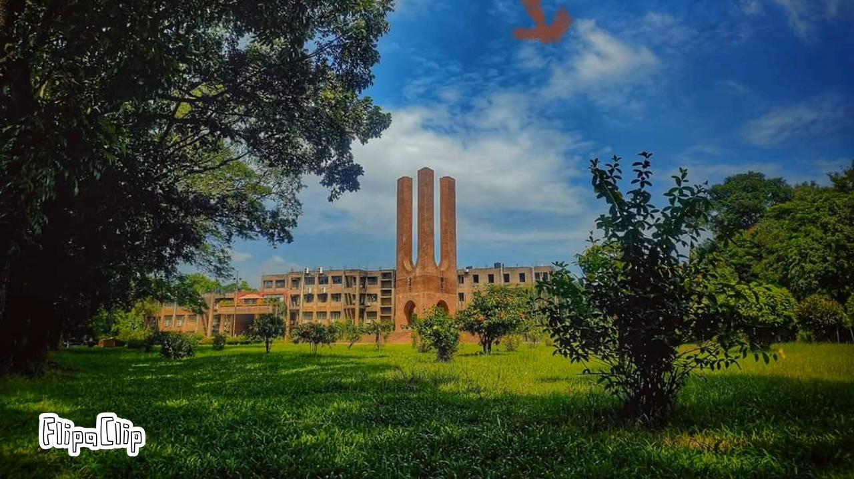
Completed part

Slide 8
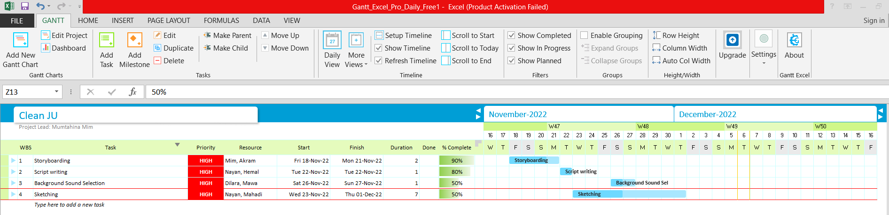
Project Overview

Slide 9
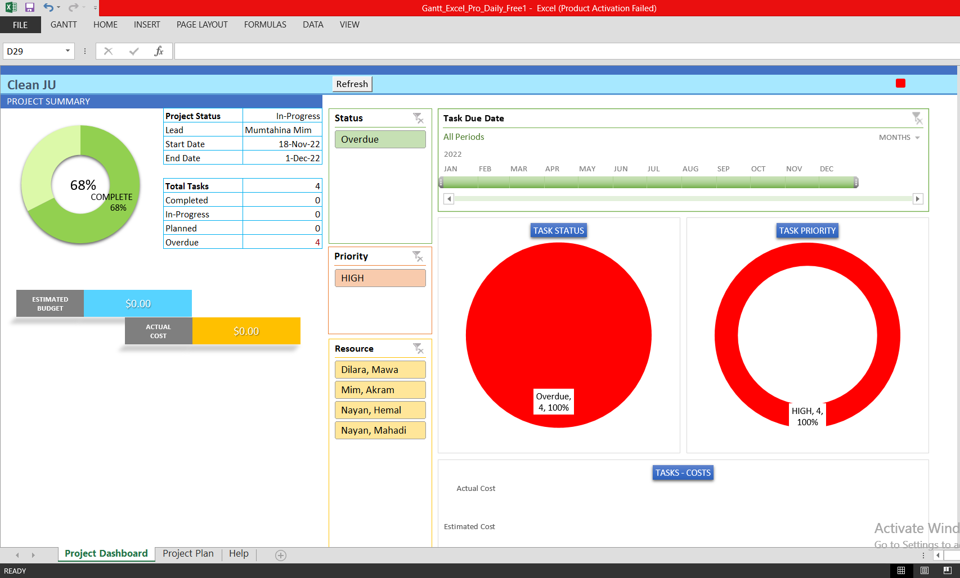
Project Dashboard

Slide 10
Hindrances
Lack of proper sketching tool.
Softwares are expensive.
Modeling.
Character rigging.
Motion.

Slide 11
Next week progress proposal
Voice Recording.
Sound Mixing.
Creating rest of the animation elements.
Video Editing.
Adding Effects.

Slide 12
Thank You

